Slide 1
Gastric Outlet Obstruction: Current Status and Future Directions

Slide 2
INTRODUCTION
Gastric outlet obstruction (GOO), otherwise called pyloric obstruction or stenosis, is a debilitating condition that results from the mechanical compression and blockage of the distal stomach, pyloric antrum, or duodenum.
It can result from both benign and malignant conditions with the most common causes including peptic ulcer and periampullary and gastric cancer respectively.
Patients present with clinical manifestations, depending on the extent of stenosis and the duration of gastrointestinal discontinuity, starting with pain and vomiting that will lead to weight loss and deterioration of the general nutritional and hydration status.

Slide 3
ETIOLOGY–EPIDEMIOLOGY
Upper gastrointestinal tract diseases that can be complicated with GOO comprise both benign and malignant disorders.
gastric or duodenal ulcers used to be the prevailing etiology for GOO.

Slide 4
Benign cause
Although they still account for most cases with a benign cause, their incidence has significantly decreased due to extensive eradication of Helicobacter pylori infection and the equally extensive use of proton pump inhibitors.
Other non-neoplastic causes of GOO include strictures from chronic pancreatitis, nonsteroidal anti-inflammatory drugs or Crohn’s disease, caustic ingestion, surgical anastomosis scarring, or adhesions.

Slide 5
Malignant causes
Among the malignant causes of GOO, gastric cancer and periampullary tumors (pancreatic adenocarcinoma, cholangiocarcinoma, cancer of the ampulla of Vater, and duodenal adenocarcinoma) predominate.
Other neoplasms have also been reported to cause GOO, including hepatocellular carcinoma, lymphoma, metastases to the duodenum or jejunum, and lymph node adenopathy

Slide 6
CLINICAL MANIFESTATIONS
Patients with GOO generally present with progressive symptoms like nausea, intractable vomiting, regurgitation, and pain.
Vomiting may initially manifest following intake of solid meals and then gradually progress to solid intolerance due to the inability of emptying of the stomach.
Epigastric pain, abdominal distention, and early satiety should be of primary concern since they can lead to weight loss, dehydration, electrolyte disturbances, and hypoalbuminemia due to malnutrition.
Overall, this combination of symptoms experienced by patients’ needs to be investigated in-depth so that they are not mistakenly attributed to the primary condition’s manifestations or complications of treatment (e.g., radiation or chemotherapy).

Slide 7
DIAGNOSIS
Auscultation of the upper abdomen in patients suffering from GOO can reveal a characteristic succussion splash due to undigested food retained in the stomach for more than 3 hours after its consumption. This sign may also be heard, even without the use of a stethoscope.
Other findings on clinical examination may include cachexia, volume depletion, and clinical signs suggestive of the underlying disease, for example, a palpable mass or lymph nodes.

Slide 8
DIAGNOSIS
Laboratory tests reveal abnormalities deriving from insufficient oral intake and emesis like hyperchloremic metabolic alkalosis and hypokalemia, and hypoalbuminemia.
Imaging studies can also be of value. An initial abdominal X-ray can show an enlarged gastric bubble, a dilated proximal duodenum, and limited presence of air in the small bowel. Further contrast studies using barium or watersoluble contrast and computed tomography or magnetic resonance imaging are helpful to unveil the anatomic obstruction site and severity.

Slide 9
The test of choice for the diagnosis of GOO is upper gastrointestinal endoscopy which offers a direct visual assessment of the stricture and can allow tissue sampling to help for a histological differentiation between benign and malignant blockages.
Finally, in patients with a malignant cause of GOO, endoscopic ultrasonography can also be a valuable tool in tissue sampling using fine-needle-aspiration of otherwise inaccessible tumors, thus facilitating diagnosis, as well as locoregional staging.

Slide 10
MANAGEMENT
Initial management of patients with a confirmed diagnosis of GOO requires correction of their general status
initially avoiding ingestion of solid foods in case the patient cannot ingest them
administration of intravenous fluids with the aim of correcting an electrolyte imbalance
gastric decompression by inserting a nasogastric tube
proton pump inhibitors to decrease the secretions of the stomach.

Slide 11
Afterwards, targeted therapy depending on the etiology of the obstruction is indicated and may include management of peptic ulcer disease (by eradicating respective risk factors, such as H. pylori infection and/or cessation of nonsteroidal anti-inflammatory drugs) and radiotherapy or chemotherapy of malignant conditions.
Conservative management might ultimately lead to more invasive options, as patients who initially respond well to nonoperative management, might relapse and may ultimately require surgery.
Traditional therapeutic options for GOO due to peptic ulcer disease that persist despite conservative treatment as well as endoscopic dilation include mainly surgical therapeutic options (open or laparoscopic), such as vagotomy and pyloroplasty.

Slide 12
Surgical gastrojejunostomy(SGJ)
Self-expandable metal stents(SEMS)
Endoscopic ultrasound-guided gastroenterostomy (EUS-GE)

Slide 13
. Surgical gastrojejunostomy
Surgical gastrojejunostomy (SGJ) is a technique that was developed to create a bypass in patients with mostly malignant GOO, in order to maintain adequate oral nutrition. It is performed under general anesthesia, either as an open procedure or laparoscopically.
It is most commonly performed in patients with tumors deemed as unresectable, who may well benefit from a long-lasting palliative gastric anastomosis, in case they are expected to have a life expectancy of several months, which should be long enough to overcome the short-term morbidity and mortality burden of the surgical procedure.

Slide 14
laparoscopic
The laparoscopic version of the technique has been associated with improved morbidity and mortality rates, as well as improved outcomes (including shorter hospitalization, shorter intervals to resume eating, reduced intraoperative hemorrhage and reduced needs for postoperative opiates).
There are two variants of the laparoscopic technique, that is, the antecolic and retrocolic method, with the former being the most commonly used.
It should be noted that for patients in whom the aforementioned surgical therapies are not an option (especially those at risk of not tolerating such an approach) or have failed, an alternative could be to place a percutaneous gastrostomy for gastric decompression, combined with subsequent placement of a jejunal feeding-tube.

Slide 15
Self-expandable metal stents
A less invasive intervention for the palliation of GOO of malignant origin is endoscopic enteral stenting .
The technique is performed using a flexible gastroscope that should be inserted to the obstruction site, which is usually evaluated by a combination of endoscopy and/or injection of contrast proximal to and immediately distal to the stricture, in order to assess its length and endoscopic characteristics, including the degree of luminal obstruction it causes;

Slide 16
self-expandable metal stents (SEMS)
self-expandable metal stents (SEMS) are those that seem to be the most effective choice to recanalize a significantly narrowed lumen.
uncovered (USEMS)
covered (CSEMS)
partially covered (PCSEMS) designs

Slide 17
The selection of SEMS that suits best in a specific case should be personalized, based on the stent’s technical features, taking into account potential complications, in combination with the specific characteristics of the patient’s underlying cause of GOO.
Studies suggest that all types of SEMS are comparable in terms of technical success (ranging between 89% and 98%)
clinical success (usually defined as the relief of obstructive symptoms and improvement of oral intake, ranging between 63% and 93%)

Slide 18
Migration is more commonly seen after placement of CSEMS or PCSEMS, as the cover prevents effective anchorage that is more likely to possible when using USEMS;
The benefit of reduced migration of USEMS should be balanced by the increased risk of stent occlusion (and thus recurrence of symptoms of the obstruction) in USEMS due to tumor ingrowth or overgrowth, or even mucosal hyperplasia as a result of increased pressure by the stent on the duodenal mucosa causing non-neoplastic tissue ingrowth

Slide 19
USEMS are currently most frequently used for managing malignant GOO in the majority of cases, as they combine reduced migration rates, more flexibility and also allow for better bile outflow (through the stent’s mesh interstices) in case the stent is placed across the duodenal papilla.
Design changes and precautions to reduce migration rates of PCSEMS and CSEMS have been attempted (e.g., anti-migration modifications of the stent or applying clips or sutures to fix the stent to the wall), but most of these efforts were found to be not successful.

Slide 20
AE of SEMS
AE are usually divided into minor and major (i.e., life threatening)
Minor AE of SEMS placement include among others epigastric pain or nausea and vomiting
Major AE include bleeding, perforation and fracture of the stents

Slide 21
This was reaffirmed in the aforementioned Dutch systematic review of prospective reports with duodenal SEMS, where obstruction and migration were reported in 12.6% and 4.3% of cases respectively, whereas the perforation rate was 1.2% and major bleeding was reported in 0.8% of patients (although overall bleeding was somewhat higher, i.e., 4.1% of cases).
Moreover, except for stent occlusion and migration, and cholangitis (due to obstruction of bile flow), the other AEs seem to be balanced between USEMS on the one hand and PCSEMS/CSEMS on the other hand.

Slide 22
. Endoscopic ultrasound-guided gastroenterostomy
EUS has evolved in recent years from a merely diagnostic procedure to an indispensable interventional endoscopic technique that offers solutions when other endoscopic techniques reach their limits or are no longer possible.
As the technique combines endoscopy with ultrasonography it allows, with the help of recently developed accessories, for expansion of therapeutic endoscopic options even outside the luminal gastrointestinal tract.

Slide 23
Interventional EUS has shown promising results with regard to decompression of the pancreatobiliary tract, but more recently also in establishing patency between the stomach and distal duodenum/proximal jejunum in case of GOO.
Although EUS-GE has been around since 2002, it has only recently been more widely implemented and this could partly be attributed to a change in mentality towards EUS as therapeutic instrument, which is therefore now evolving to an interventional technique, and partly by the more recent development of new EUS-dedicated accessories, with the most characteristic example being the introduction of LAMS.

Slide 24
LAMS
LAMS are an evolution of CSEMS, with the basic difference of LAMS from a “typical” CSEMS being the design of its stent ends:
LAMS are made with wide flanges on both ends, providing improved anchoring and an even distribution of pressure on the luminal walls.
Three types of LAMS are nowadays widely used, namely:
AXIOS (Boston Scientific Corp., Marlborough, MA, USA)
NAGI (Taewoong Medical Co., Goyang, Korea)
Spaxus (Taewoong Medical Co.)

Slide 25
Three basic techniques have been used to create this bypass:
The direct technique
The balloon-assisted technique
The EPASS (EUS-guided double-balloon-occluded gastrojejunostomy bypass) technique.

Slide 26
direct EUS-GE
A puncture of the small bowel loop that is adjacent to the gastric wall is performed using a needle (usually 19-gauge). Ultrasonographic visualization of this adjacent loop is facilitated by injecting saline or diluted contrast through a duodenal tube that was previously inserted distally to the obstruction using endoscopic guidance. The water- (or contrast-) filled segment is identified with the linear echoendoscope and after it is punctured, either a guidewire is passed through the needle, which is then used to guide placement of a LAMS, or alternatively a cautery-enhanced LAMS (HOT AXIOS; Boston Scientific Corp.) can be used directly, thus avoiding use of a guidewire and minimizing the risk of “pushing away” the small bowel loop from the stomach.

Slide 27
Balloon-assisted
In the balloon-assisted procedures, a guidewire is usually placed across the stenosis under endoscopic or radiologic guidance.
Then, a balloon device (e.g., a retrieval or dilation balloon, single-balloon overtube) is advanced over the guidewire and inflated in order to help localizing the indicated puncture site, usually by puncturing (and bursting) the balloon under EUS-guidance, followed by advancement of a guidewire through the puncture needle, which is then used to guide LAMS placement.

Slide 28
EPASS technique
EPASS technique, which uses a dedicated device, i.e., a double-balloon-occlusion catheter endowed with two balloons (with 20 cm distance between them) which is inserted through the narrowed segment in the more distal bowel lumen under endoscopic control. Both balloons are filled with saline or contrast material to hold the small intestine in between open. Then saline with contrast material is introduced into the space between the two balloons to distend the small bowel lumen and thus facilitating its stabilization; the next step includes direct puncture and deployment of the LAMS.

Slide 29
In a recent clinical review including eight studies (seven retrospective and one prospective, with at least 10 patients), technical success was reported to range between 87% and 96% (reaching even 100% after some technical modifications), whereas clinical success was reported to range between 81% and 92%.
Similarly, in a recent systematic review and meta-analysis including four retrospective and one prospective study, technical success was reported to be 92.9% and clinical success 90.11%. It is important to note that these excellent results were achieved at the cost of 5.6% serious AE . among these peritonitis, perforation, bleeding and abdominal pain and 11.4% reintervention rate.

Slide 30
it should also be noted that expertise of the endoscopist is a major factor that influences outcomes in interventional EUS, as it remains a method that requires extensive training.

Slide 31
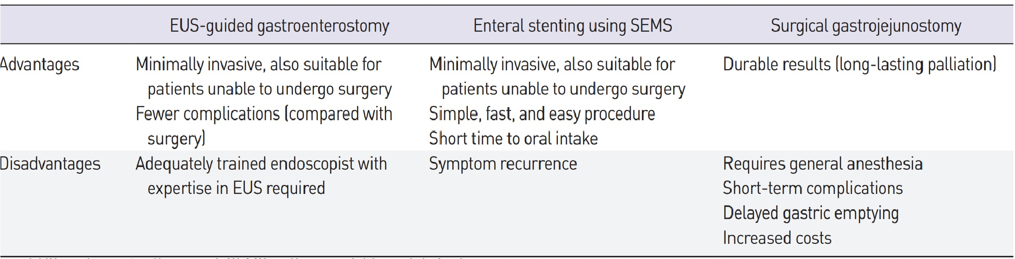

Slide 32
. SGJ versus SEMS
In most reports, high technical and clinical success rates of both methods hardly allow statistical differences to be found.
Enteral stenting requires less time to be performed compared to SGJ and procedure-related mortality was not different between both groups.
AEs after SEMS placement are mainly associated with stent dysfunction, usually re-obstruction and migration, both leading to an increased need for reinterventions.
hospital stay (and overall costs) were significantly reduced when placing SEMS, due to the minimally invasive nature of stenting compared to SGJ.

Slide 33
Overall, the decision for the most appropriate form of therapy for a specific patient should be individualized depending on whether the patient is fit enough to undergo a surgical procedure, the patient’s predicted survival and the cause of the obstruction.
SGJ seems to provide better long-term results with fewer reinterventions but should be reserved for those with a more prolonged predicted survival. A 2-month cutoff has been proposed.

Slide 34
SGJ versus EUS-GE
There is only a limited number of comparative studies between SGJ and EUS-GE available.
a systematic review and meta-analysis and demonstrated a significantly higher technical success rate for SGJ, but similar clinical success rates and significantly fewer AEs for EUS-GE.
EUS-GE should be considered a minimally invasive treatment, which however needs special training with a possibly significant learning curve and which, for the moment, should be performed in specialized centers with significant expertise. Thus, more data, especially RCTs are required, incorporating real-life results to draw more reliable conclusions.

Slide 35
SEMS versus EUS-GE
EUS-GE was demonstrated to have lower technical and higher clinical success rates, but without a significant statistical difference.
a more recent retrospective study including 100 patients (22 underwent EUS-GE and 78 SEMS placement) reported higher initial clinical success for the EUS-GE group (95.8% vs 76.3%, p=0.042)
suggest that EUS-GE is a safe and effective minimally invasive technique, overall doing better than SEMS and with results comparable to those of SGJ.

Slide 36
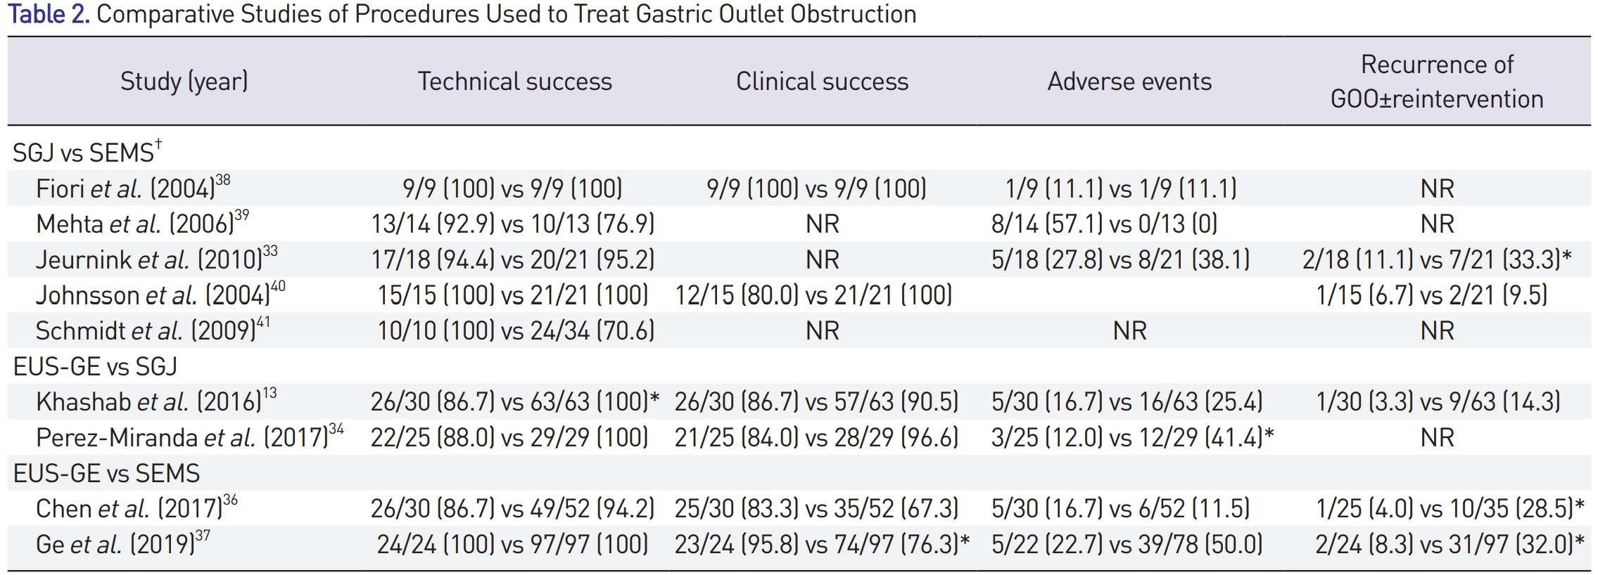

Slide 37
CONCLUSION AND FUTURE PROSPECTS
This review of the current literature seems to support that all available therapeutic tools, including SGJ, SEMS or EUS-GE are safe and effective options for the treatment of GOO, with each of them having its own advantages but also special properties.
The decision which one to perform should to a large extent depend on clinical criteria of the patient, the location and type of obstruction in the distal stomach or proximal duodenum, as well as availability and expertise of the endoscopic team.

Slide 38
When taking this into consideration, SGJ could be the best choice for patients with malignant GOO and a better life expectancy, whereas SEMS placement as a minimally invasive alternative would be preferable for patients with a worse prognosis.
SEMS placement remains the endoscopic technique most commonly performed due to the advanced stage many patients present. Finally, EUS-GE is definitely the “new kid on the block” for the minimally invasive endoscopic management of GOO and could even be efficiently utilized as a technique that combines the best aspects of the other two methods.
In our opinion, EUS-GE likely will eventually replace SGJ in the future, of course when it is clearly shown that EUS-GE is at least as effective and safe as SGJ

Slide 39
. In any case, though, it needs to be stressed that patients with GOO can be treated most effectively in a multidisciplinary environment, with more than one specialist available, with the aim to achieve better outcomes for patients with GOO.

